Slide 1

STUDENT DETAILS
PRESENTED BY : KOLLI . LAVANYA SRI VENKATA SARIKA
SKILLS BUILD EMAIL ID: KOLLISARIKA@GMAIL.COM
COLLEGE NAME : S.R.K INSTITUTE OF TECHNOLOGY
COLLEGE STATE: ANDHRA PRADESH
INTERNSHIP DOMAIN AND INTERNSHIP START AND END DATE: ARTIFICIAL INTELLIGENCE AND MACHINE LEARNING (3-JUNE-2024 TO 15-JUNE-2024)

Slide 2
EMPLOYEE BURNOUT PREDICTION/PROBLEM STATEMENT
Employee burnout is a state of physical, emotional and mental exhaustion caused by excessive and prolonged stress. It can have serious consequences on an individual’s well-being and can lead to decreased productivity and job performance. In today’s fast-paced and constantly connected world, it is increasingly important to recognize and address the signs of burnout in order to maintain the health and well-being of employees.
We will be exploring the use of regression techniques to predict employee burnout. By analyzing a dataset containing various factors that may contribute to burnout such as workload, mental fatigue job and work-life balance, we can develop a model to identify individuals who may be at risk of burnout. By proactively addressing these risk factors, organizations can help prevent burnout and promote the well-being of their employees

Slide 3
AGENDA
Problem Statement
Project Overview
Who are the end users of the project?
Solution and its value proposition
How did you customize the project and make it your own
Modelling
Results
Links

Slide 4

PROJECT OVERVIEW (INTRODUCTION): DEFINING EMPLOYEE BURNOUT
Employee burnout is a state of physical, emotional, and mental exhaustion caused by prolonged and excessive stress at work. It often results from chronic workplace stress that has not been successfully managed. Burnout can significantly impact an individual’s well-being and job performance.
Emotional Exhaustion:
Feeling drained and depleted of emotional resources.
Overwhelming fatigue that doesn't improve with rest.
Depersonalization:
Developing a cynical attitude towards one's job and colleagues.
Detachment and a sense of disconnection from work and coworkers.
Reduced Personal Accomplishment:
Feeling ineffective and lacking a sense of achievement.
Decreased productivity and lower work performance.
Physical Symptoms: Chronic fatigue, headaches, sleep disturbances, and gastrointestinal problem.
Emotional Symptoms: Feeling overwhelmed, irritable, anxious, and depressed.

Slide 5

WHO ARE THE END USERS OF THIS PROJECT?
The end users of an employee burnout prediction project typically include various stakeholders within an organization who are responsible for employee well-being, productivity, and overall organizational health. Here are some of the key end users:
Human Resources (HR) Department:
HR Managers and Specialists: Use the prediction model to identify at-risk employees and develop intervention strategies.
Line Managers and Supervisors:
Team Leaders: Monitor their team members' well-being and address burnout proactively.
Department Heads: Implement department-wide changes to reduce burnout risks.
Employee Assistance Programs (EAP):
EAP Coordinators: Tailor support services and counseling based on the burnout risk data.
Data Analysts and IT Departments:
Data Scientists and Analysts: Develop, refine, and maintain the burnout prediction
model.
IT Support: Ensure the technical infrastructure supports the data collection and analysis process.
Employees:
Self-awareness: Employees may have access to personal burnout risk assessments and resources to manage stress and seek support.

Slide 6
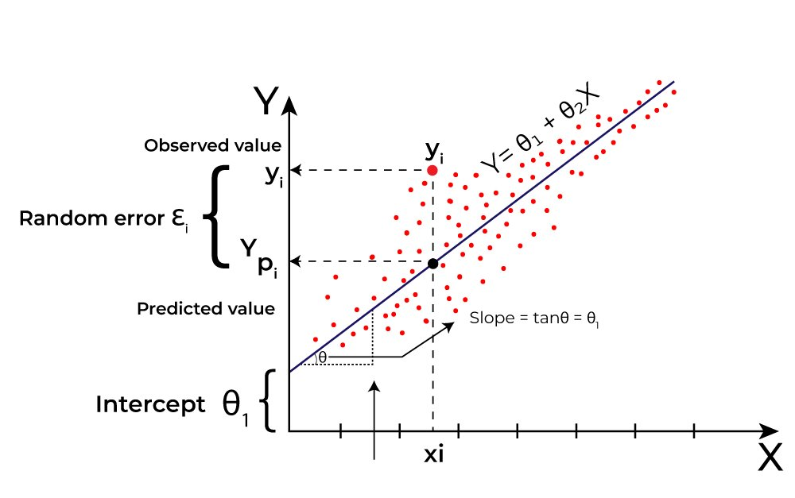
SOLUTION AND ITS VALUE PROPOSITION
The solution involves developing a predictive model using machine learning and Linear Regression & Linear SVM techniques to identify employees at risk of burnout. This model will analyze various factors contributing to burnout and provide actionable insights to stakeholders within the organization.
Linear Regression : It is a type of Supervised Machine Learning algorithm that computes the linear relationship between the dependent variable and one or more independent features by fitting a linear equation to observed data.
There are 2 types of Linear Regression:​
1. Simple Linear Regression.​
2. Multiple Linear Regression.​
Support Vector Machine : Support Vector Machine (SVM) is a Supervised Machine Learning algorithm used for both classification and regression.​

Slide 7
VALUE PROPOSITION
Proactive Burnout Prevention:
Early Detection: Identify employees at risk of burnout before it becomes severe, enabling timely interventions.
Reduced Absenteeism and Turnover: By addressing burnout early, reduce the rates of absenteeism and employee turnover.
Enhanced Employee Well-being:
Improved Job Satisfaction: Increase employee satisfaction by addressing the root causes of burnout.
Better Work-Life Balance: Help employees achieve a healthier work-life balance through targeted interventions.
Increased Productivity and Performance:
Higher Productivity: Employees who are not burned out are more productive and engaged in their work.
Improved Performance: Enhanced employee performance through better mental and physical health.
Data-Driven Decision Making:
Strategic Insights: Provide HR and management with data-driven insights to make informed decisions about employee well-being and organizational policies.
Resource Allocation: Optimize resource allocation by focusing efforts on high-risk areas and employees.
Cost Savings:
Lower Recruitment Costs: Save on recruitment and training costs by reducing turnover rates.
Enhanced Organizational Culture:
Positive Work Environment: Foster a positive work environment where employees feel valued and supported.
Employer Brand: Enhance the organization's reputation as a caring and supportive employer, attracting and retaining top talent.

Slide 8
HOW DID YOU CUSTOMIZE THE PROJECT AND MAKE IT YOUR OWN
Customizing the project to make it your own involves several steps. Here are some ways to tailor the project to fit your unique needs and context:
​ 1. Understanding the Domain :
Burnout Indicators: Identify burnout indicators specific to your organization or industry. For example, in healthcare, patient load and shift hours might be crucial, while in tech, project deadlines and overtime might be more relevant.
2. Data Collection Enhancements :
Survey Design: Create a customized survey to collect additional data directly from employees, including qualitative feedback and then integrate into multiple data sources.
3. Advanced Data Preprocessing :
Feature Engineering: Create new features from existing data. For example, calculate the ratio of overtime hours to regular hours, or create an index of work-life balance.
4. Enhanced Outlier Detection :
Domain-Specific Outliers: Customize outlier detection to identify domain-specific outliers.
Advanced Techniques: Use advanced outlier detection techniques like Isolation Forest or DBSCAN.
5. Customized Correlation Analysis :
Partial Correlation: Use partial correlation to control for confounding variables and better understand direct relationships.
Feature Interaction: Analyze interactions between features to see how they jointly affect burnout.
6. Model Customization :
Multiple Models: Experiment with different types of models beyond linear regression, such as Decision Trees, Random Forests, or Gradient Boosting Machines.
Hyperparameter Tuning: Perform hyperparameter tuning to optimize model performance.

Slide 9
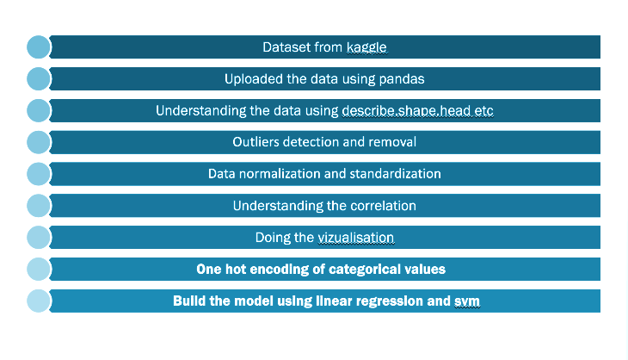
MODELLING

Slide 10
Linear Regression
Linear regression analysis is used to predict the value of a variable based on the value of another variable. The variable you want to predict is called the dependent variable. The variable you are using to predict the other variable's value is called the independent variable.
Key Concepts of Linear Regression:
Dependent Variable (y): This is the variable you are trying to predict or explain. It's the outcome you're interested in.
Independent Variable (x): This is the variable you believe influences the dependent variable. It's the factor you think causes changes in the dependent variable.
Linear Equation (y = mx + b): This equation represents the relationship between the independent and dependent variables.
1. Slope (m): This indicates the change in the dependent variable (y) for a one-unit change in the independent variable (x). A steeper slope signifies a stronger influence of x on y.
2. Y-intercept (b): This is the predicted value of the dependent variable (y) when the independent variable (x) is zero.
Finding the Best-Fit Line: Linear regression doesn't pick a random line. It analyzes all data points to find the line that minimizes the overall difference between the predicted y values (using the equation) and the actual y values observed in the data. This minimization of the discrepancies between predicted and actual values is crucial for creating an accurate model.
Prediction: Once we have the best-fit line, we can use it to predict future values of the dependent variable for unseen independent variable values.
Evaluation Metrics: We can assess how well a linear regression model fits the data using various metrics like R-squared and mean squared error (MSE). These metrics help us gauge the model's accuracy and identify potential issues.

Slide 11
Outlier Detection and Removal
Outliers are data points that deviate significantly from the majority of the data. They can occur due to variability in the data or errors in measurement, and can have a significant standardization transforms the data to have a mean of 0 and a standard deviation of 1. This technique is useful when the data follows a Gaussian (normal) distribution.
Visual Method:
There are many methods for outlier detection but Box plot is used in this model.
Box Plot: Visualize the distribution of data and identify outliers as points outside the whiskers.
Importance of Outlier Detection and Removal
Model Accuracy: Outliers can skew the results of statistical analyses and predictive models, leading to inaccurate conclusions and predictions.
Data Quality: Identifying and handling outliers improves the overall quality and reliability of the dataset.
Assumptions: Many statistical methods assume that the data follows a certain distribution, which outliers can violate.

Slide 12
One-hot encoding of categorical variables
One-hot encoding is a technique used to convert categorical data into a format that can be provided to machine learning algorithms to improve model performance. Many machine learning algorithms cannot handle categorical data directly, so it must be converted into a numerical format.
Why One-Hot Encoding?
Machine Learning Compatibility: Algorithms like linear regression, logistic regression, and neural networks require numerical input.
Avoids Ordinal Relationships: Unlike label encoding, one-hot encoding does not imply any ordinal relationship between categories.
What is One-Hot Encoding?
One-hot encoding transforms each categorical value into a new binary column. Each unique category value is represented as a binary feature (0 or 1).
Note: You can use the pandas library for one-hot encoding
One-hot encoding is a fundamental technique for preparing categorical data for machine learning models. While it has the advantage of preserving the categorical nature of the data without implying any ordinal relationship, it can also lead to high-dimensional and sparse datasets. Understanding when and how to use one-hot encoding is crucial for effective data preprocessing and model building.

Slide 13
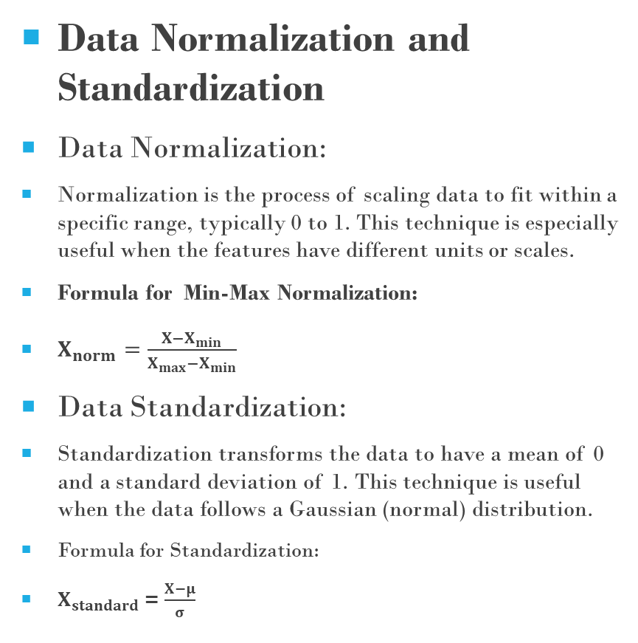
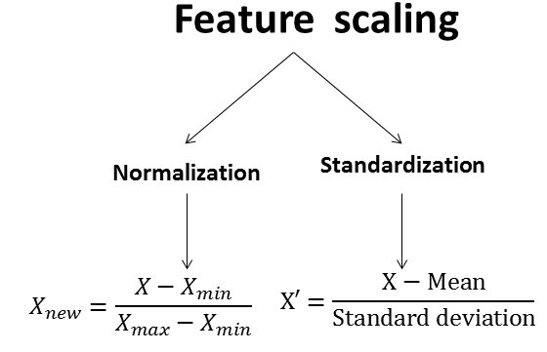
DATA NORMALIZATION AND STANDARDIZATION

Slide 14
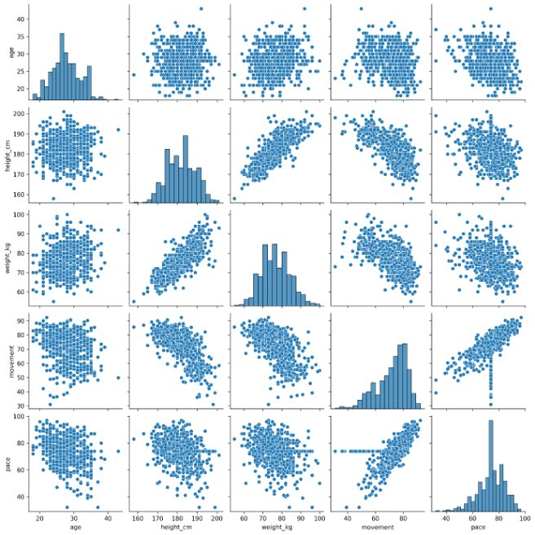
CORRELATION HEATMAP GENERATION
Correlation Heatmap Generation
A correlation heatmap is a useful way to visually explore the relationships between variables in a dataset, a correlation heatmap using Python, specifically using the seaborn and matplotlib libraries.
The visualization helps you understand which variables are strongly correlated, which can guide feature selection and multicollinearity checks when building linear regression models or other predictive models. Adjust the parameters and styling as needed to suit your dataset and presentation requirements

Slide 15
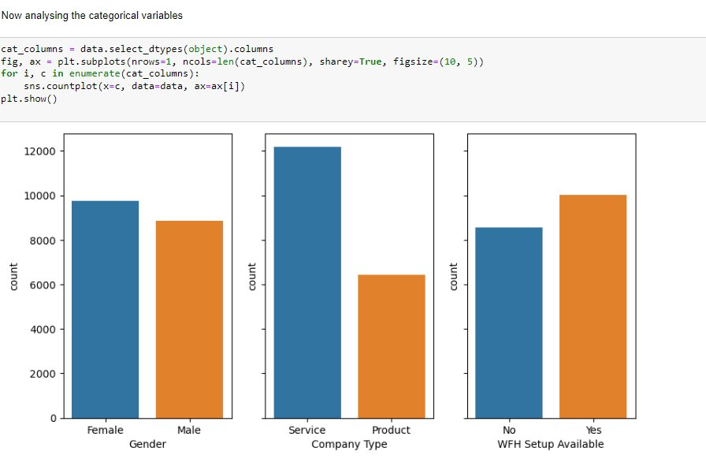
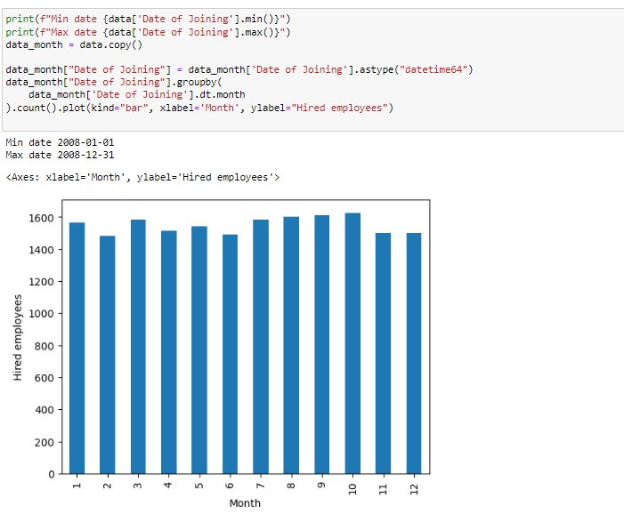
RESULTS
Analyzing the categorical variables :
2. Analyzing the correlation of Date Of Joining with target values :

Slide 16
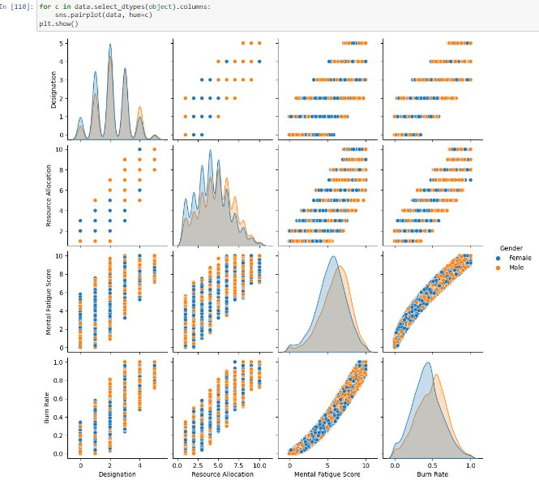
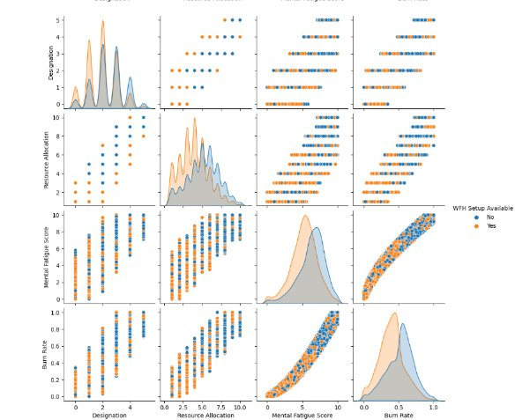
The number of observations of each category on each variable is equally distributed :

Slide 17
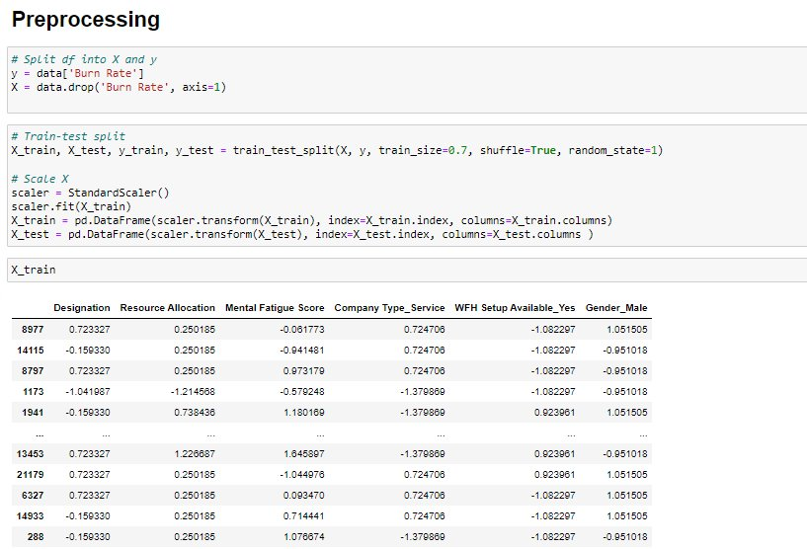
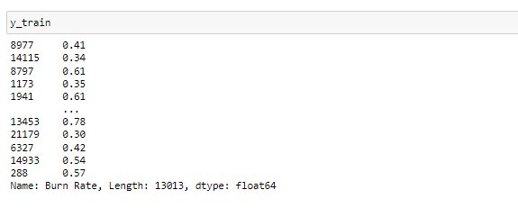
Data Preprocessing :

Slide 18
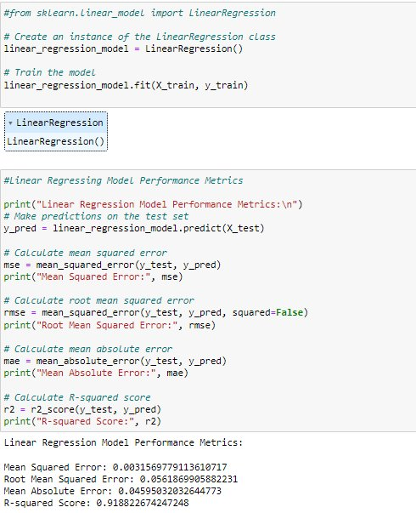
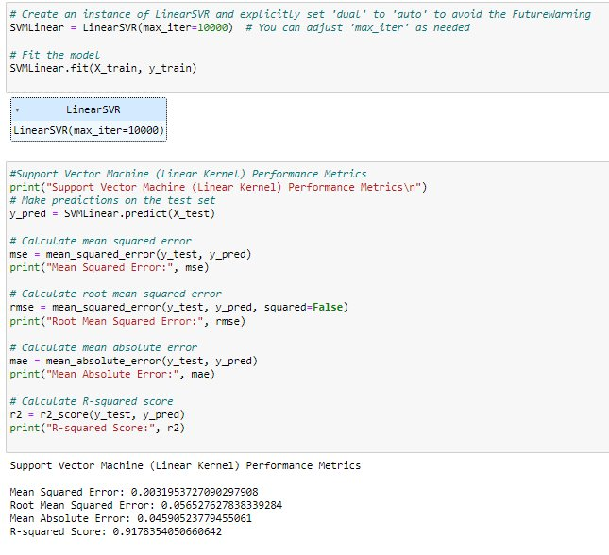
Model Building :
1. Linear Regression :
2. Linear SVM (Support vector machine) :

Slide 19
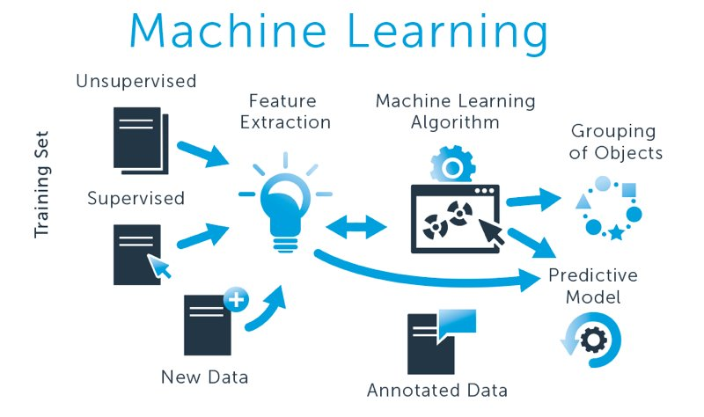
Conclusion :
Final results, tells that Linear Regression has the lowest Mean Squared Error, Root Mean​ Squared Error and Absolute Mean Error ​ and highest accuracy which has been calculated using R-Squared Error when compared to the Support Vector Machine​ (Linear SVR) which gives more highest mean square root and lowest accuracy.
In conclusion, selecting the right model is vital for building effective machine learning models that are accurate, efficient and meet the specific needs of your task.​

Slide 20
LINKS
Project Drive Link :
https://drive.google.com/drive/folders/11wc5UFY6HyM3QnNH0wdiHLorBgnTyveI?usp=drive_link

